Slide 1
Speed Measurement of Front Vehicle Using Video
Submitted by
Rakib
Roll: 1807025
4th year 1st semester
Supervised By:
Dr. Sk. Mohammad Masudul Ahsan
Professor,
Department of Computer Science and Engineering
Khulna University of Engineering & Technology

Slide 2
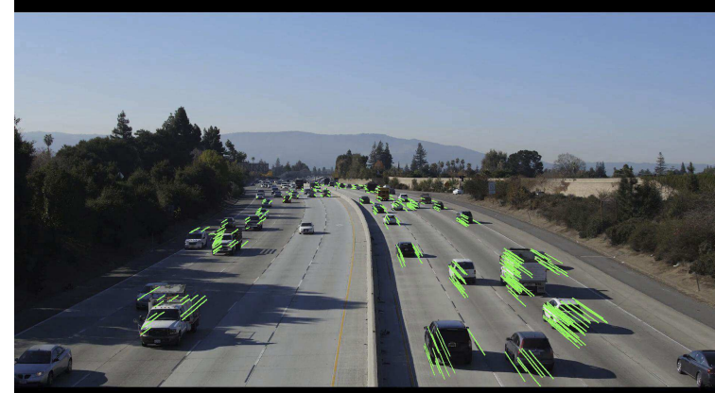
Progress
Literature Review
Shuai Hua[1] worked on detecting speed.
They work on dataset track-1
First detect and then track vehicle.

Slide 3
Progress
This dataset has a reference speed of road
In this method, one vehicle must drive on that reference speed.
They do some mathematical calculation on that reference vehicle and calculate other vehicle’s speed

Slide 4
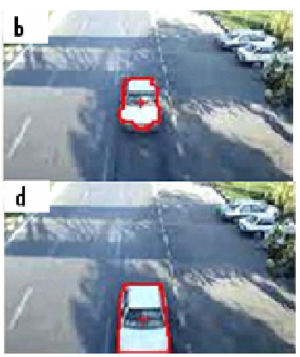
Progress
Arash Gholami Rad[2] detect and calculate the speed of vehicle in their work
Detect and track vehicle using blob detection and identify centroids

Slide 5
Progress
record the information of each vehicle’s centroids and bounding boxes
Calculate distance using the coordinate of centroids of each frame
Calculate the speed by deviding the distance with time

Slide 6
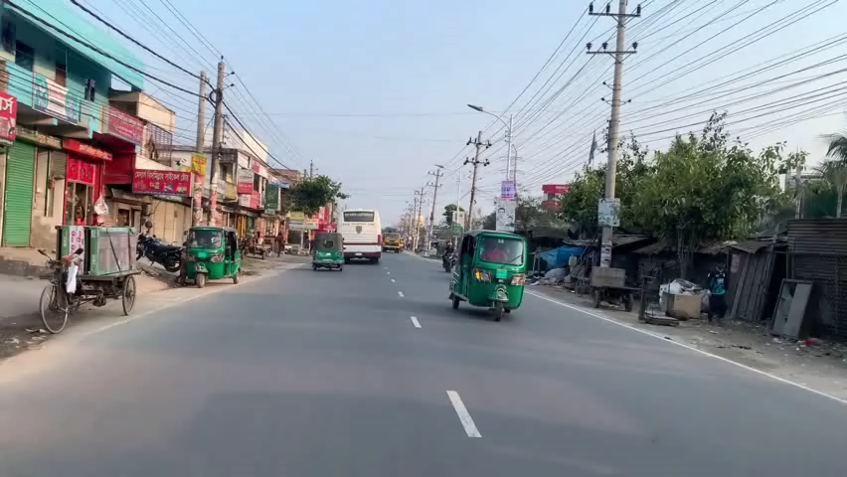
Progress
Merge yolov8 with deepsort for tracking the object
Use pretrained yolov8 model for detecting

Slide 7
Camera
α1
α2
h
d2
d1

Slide 8
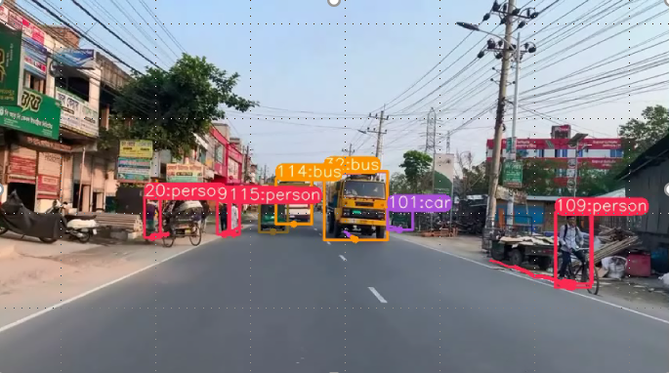
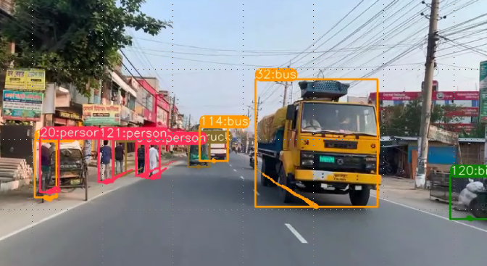

Slide 9
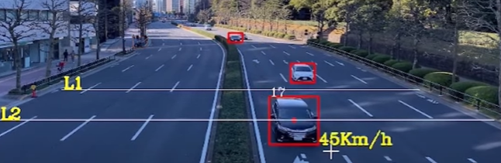

Slide 10
Progress
f
h
h’
f
d’
d

Slide 11
Progress
We know that,
1/f = 1/d’ + 1/d ….(i) where d = object distance
And |h/h’| = d/d’ ….(ii) d’ = image distance
h = object height
h’ = height in image
Let
|h/h’| = d/d’ = c …..(iii)
Now from eqn i
d/f = d/d’ + 1 from (i)
= c + 1 from (iii)
d = (c + 1)*f ……(iv)

Slide 12
Progress
For finding f
From eqn (iv)
f = d/(1+c) …..(v) where d = real distance
and c is ratio of image and object height
If we take a reference image of an object and tell it’s distance and real height then we can find f.
From f we can find the distance of object

Slide 13
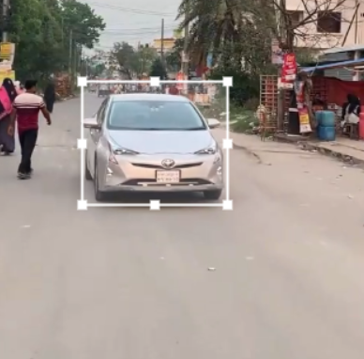
Progress
Let , we know , car height in real world is h = 60 inch
And reference image distance is d = 100 inch
Now we can find the focal length of camera from eqn (v)
Where c = h/h’ = 60/5 = 12
f = (1+ c )/d
f = 13/100
h’ = 5
d

Slide 14
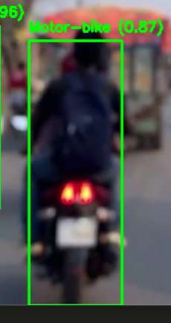
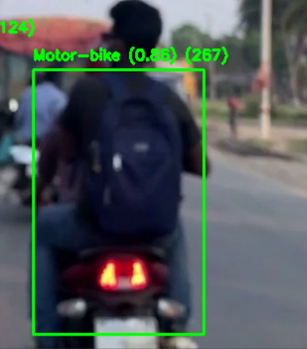

Slide 15
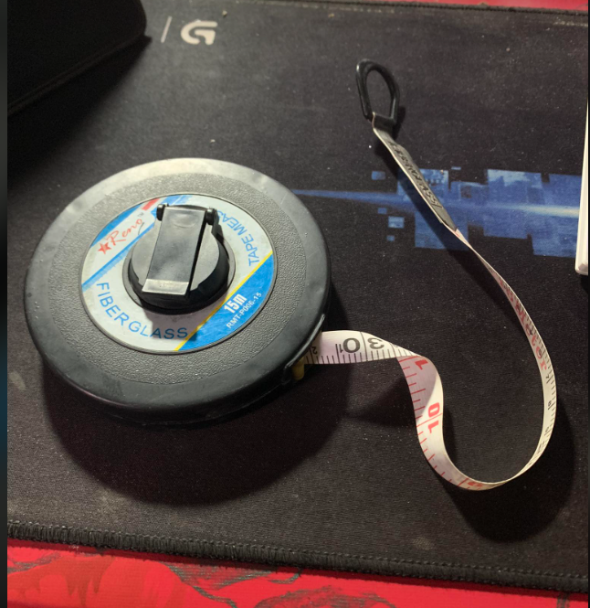

Slide 16
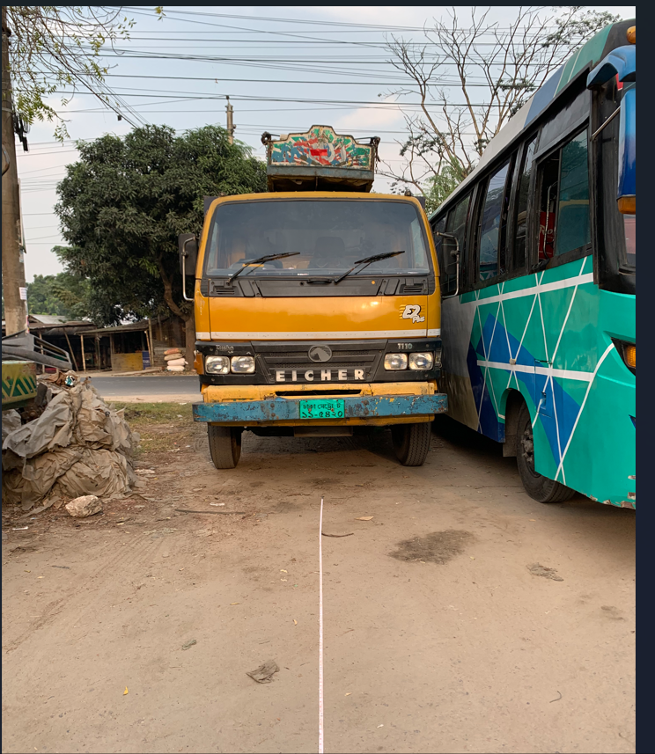

Slide 17
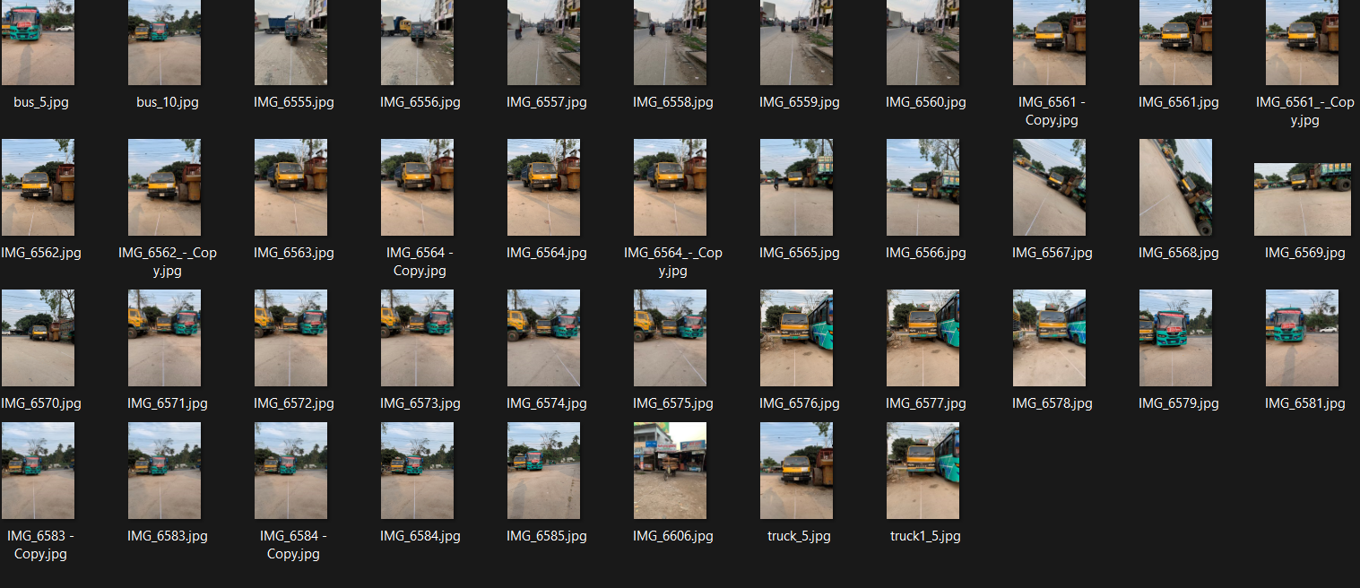

Slide 18
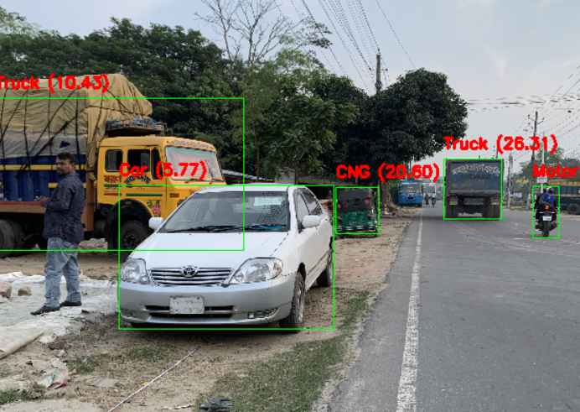
If we take only distance measurement, then
Actual distance = 5m
Measured distance = 5.7m
Error = (5.7-5)/5 *100 %
= 14%
Accuracy = 86%

Slide 19
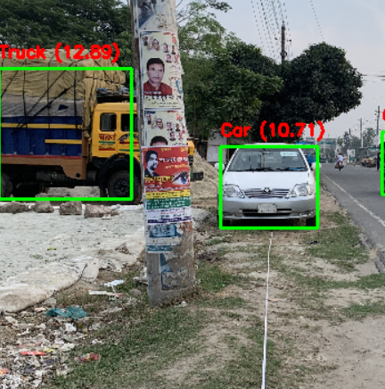
Actual distance = 10m
Measured distance = 10.71m
Error = (10.71-10)/10 *100 %
= 7.1%
Accuracy = 92.9%

Slide 20
But, if we take the difference of measurement, then:
Actual distance difference = 10m – 5m = 5m
Measured distance difference = 10.71m – 5.77m = 4.94
Error = (5- 4.94)/5 *100 %
= 1.2%
Accuracy = 98.8%

Slide 21
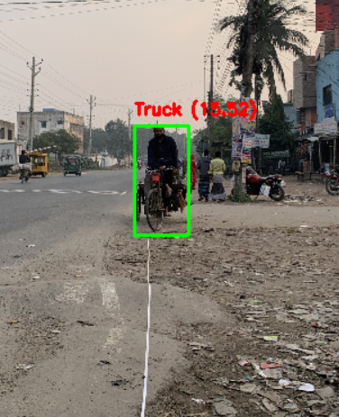
Some problems:

Slide 22
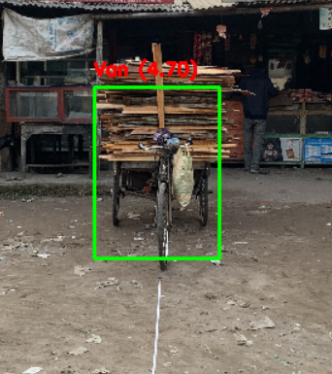

Slide 23
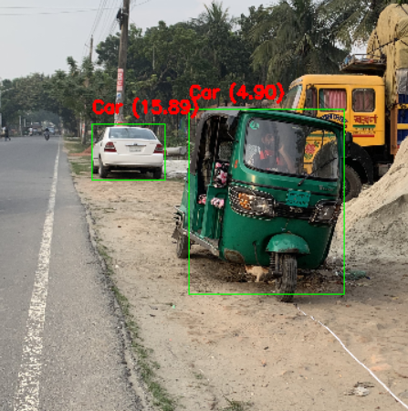

Slide 24
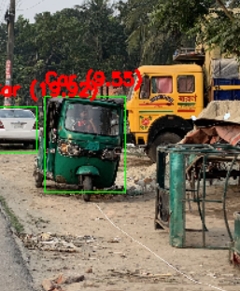

Slide 25
yolov5
X1,y1,x2,y2
Tracker

Slide 26
Inside tracker:
Calculate center point ©
If
(C1-C0)<35
Assign new id
Assign previous id
Return id

Slide 27
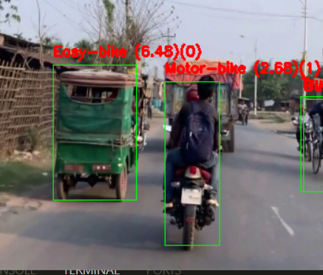
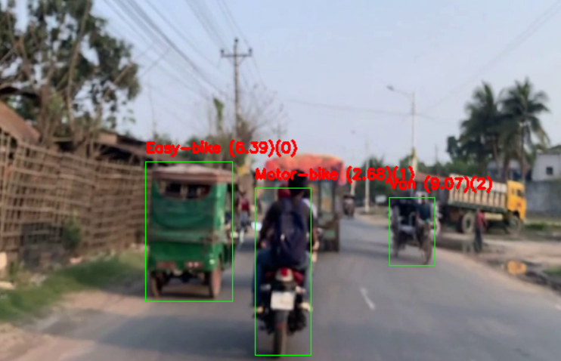
Id remains same across frame

Slide 28
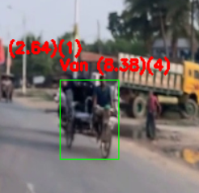
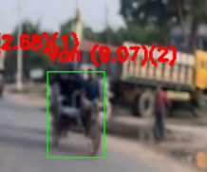
Some problem

Slide 29
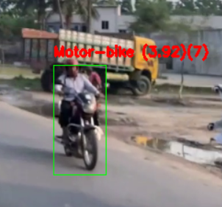
New object assign as new id:

Slide 30
Inside tracker:
Calculate center point and Bbox ratio
If
(C1-C0)<35
Assign new id
NO
NO
Return id
YES
Check ratio<0.5
Assign previous id

Slide 31
Calculate center point and Bbox ratio
If
(C1-C0)<35
NO
Assign new id
YES
Return id
NO
Check ratio>0.5
Assign previous id

Slide 32
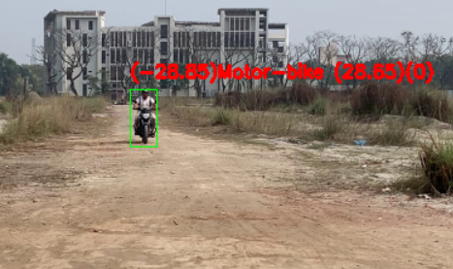

Slide 33
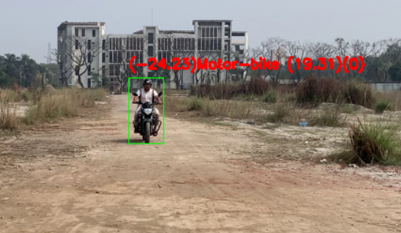

Slide 34
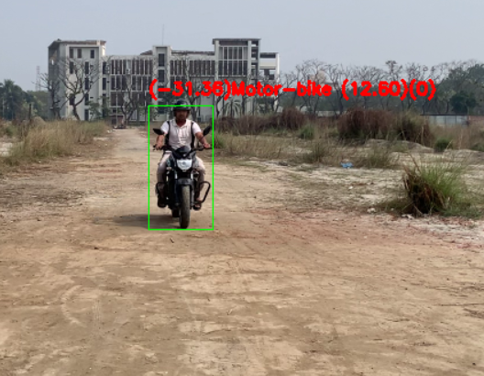

Slide 35
